Slide 1
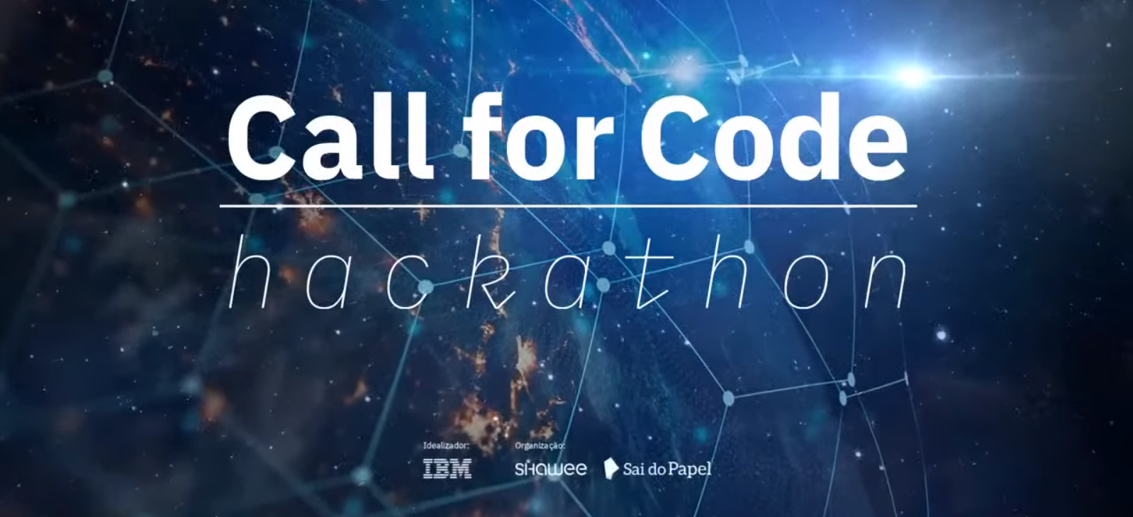
2021-07-30
Clean water and sanitation
forest4water -Nature Based Solutions (NBS) for improving water access and quality -
forest4water@gmail.com

Slide 2
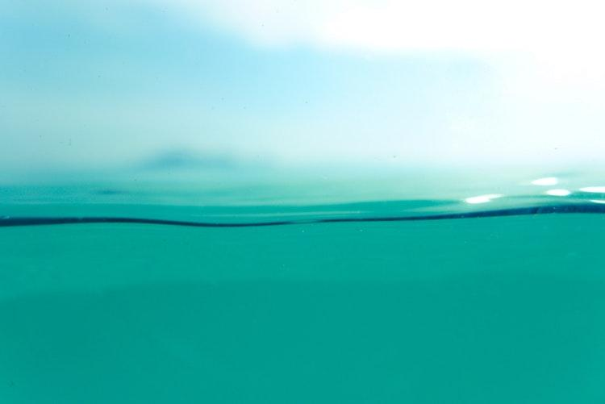
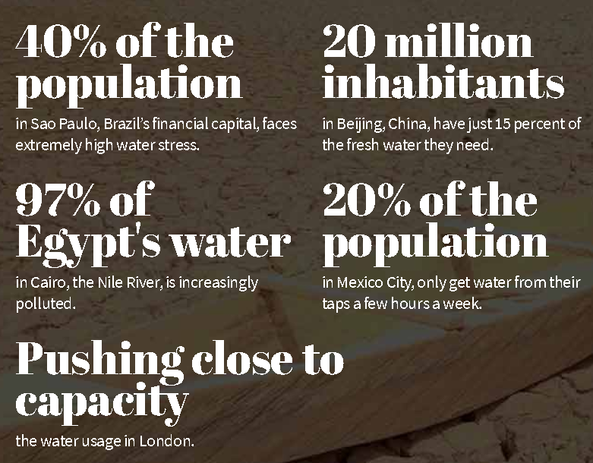
¿Where and who requires water?
gfa.org

Slide 3
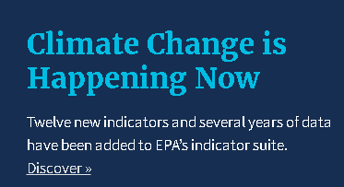
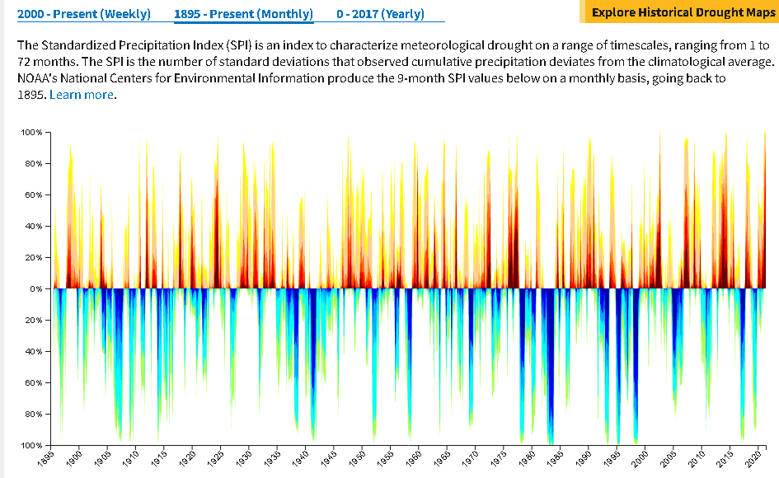
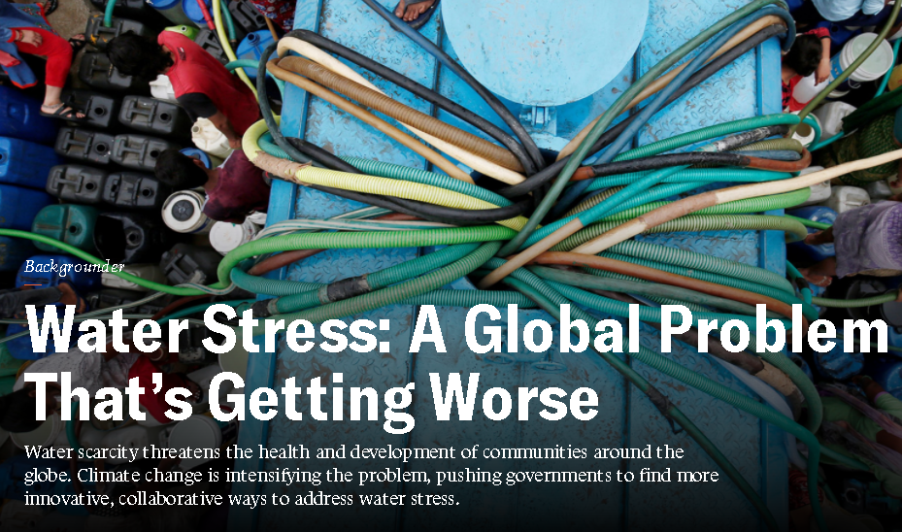
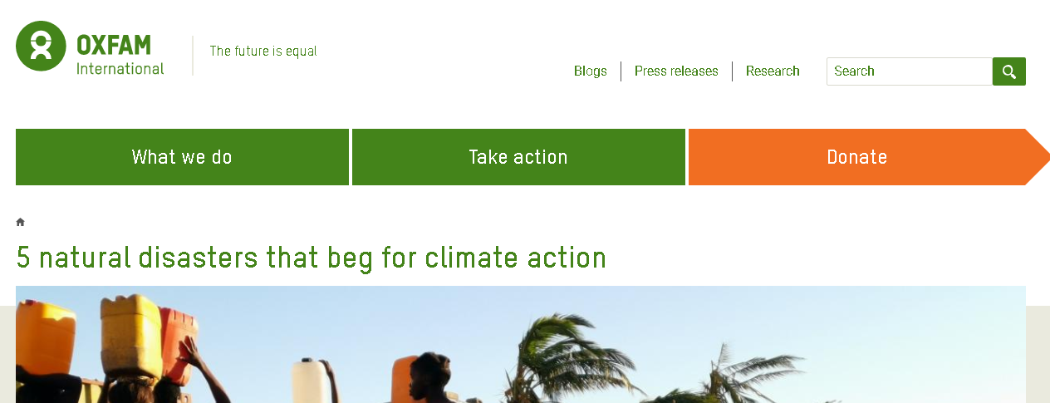
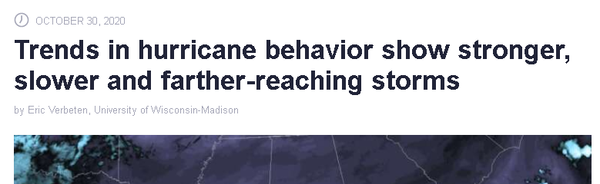
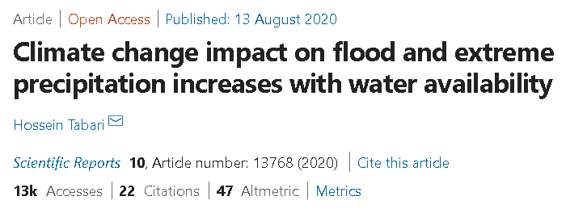
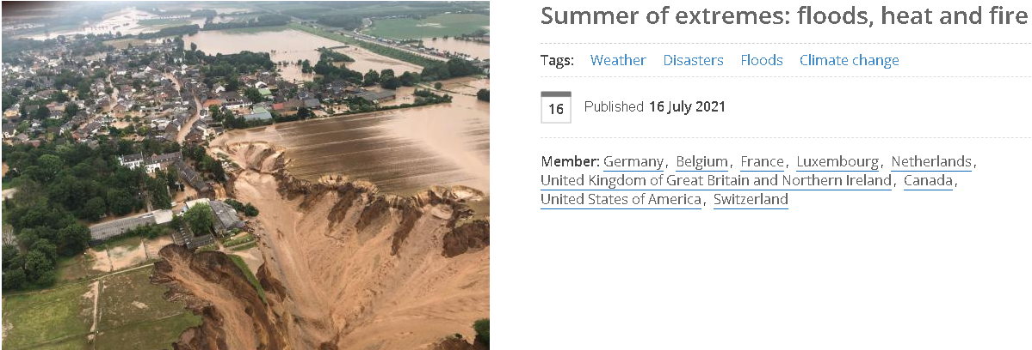
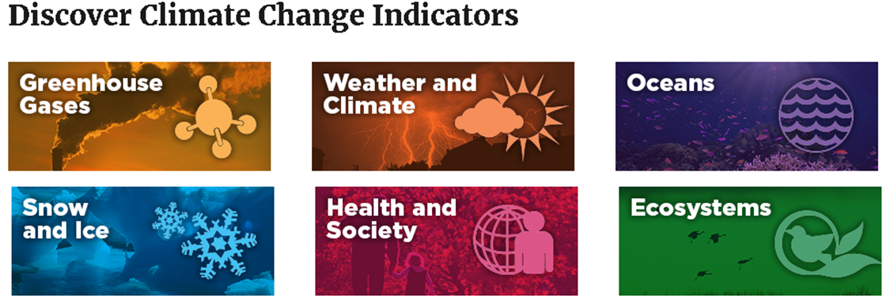
What is the problem? Climate change?
Notes:
Climate change impact on flood and extreme precipitation increases with water availability | Scientific Reports (nature.com): https://www.nature.com/articles/s41598-020-70816-2
Summer of extremes: floods, heat and fire | World Meteorological Organization (wmo.int): https://public.wmo.int/en/media/news/summer-of-extremes-floods-heat-and-fire
Water Stress: A Global Problem That’s Getting Worse | Council on Foreign Relations (cfr.org): https://www.cfr.org/backgrounder/water-stress-global-problem-thats-getting-worse
Climate Change Indicators in the United States | US EPA: https://www.epa.gov/climate-indicators

Slide 4

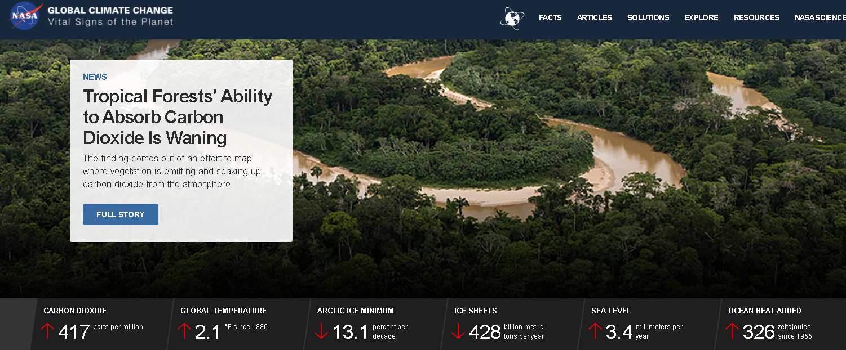
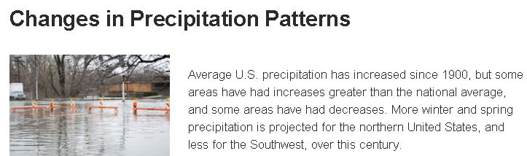
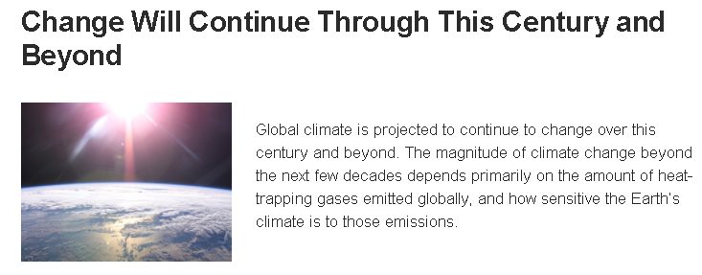
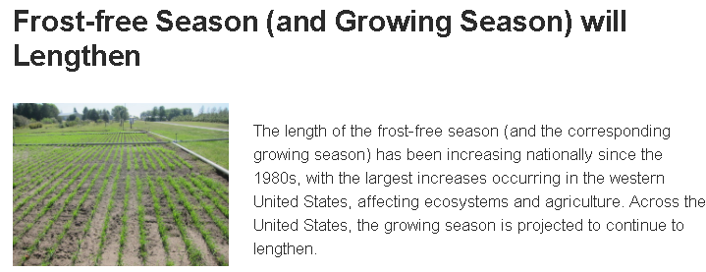
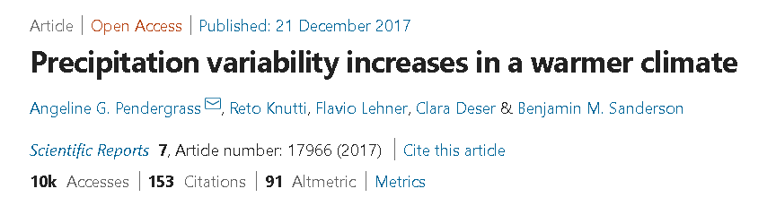
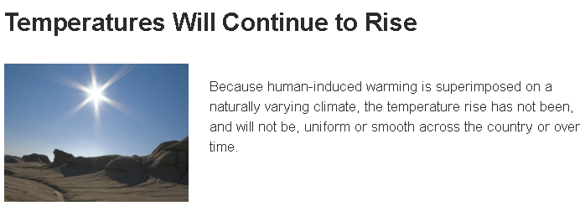
What is the orign? Human impacts?
climate.nasa.gov
climate.nasa.gov/effects

Slide 5
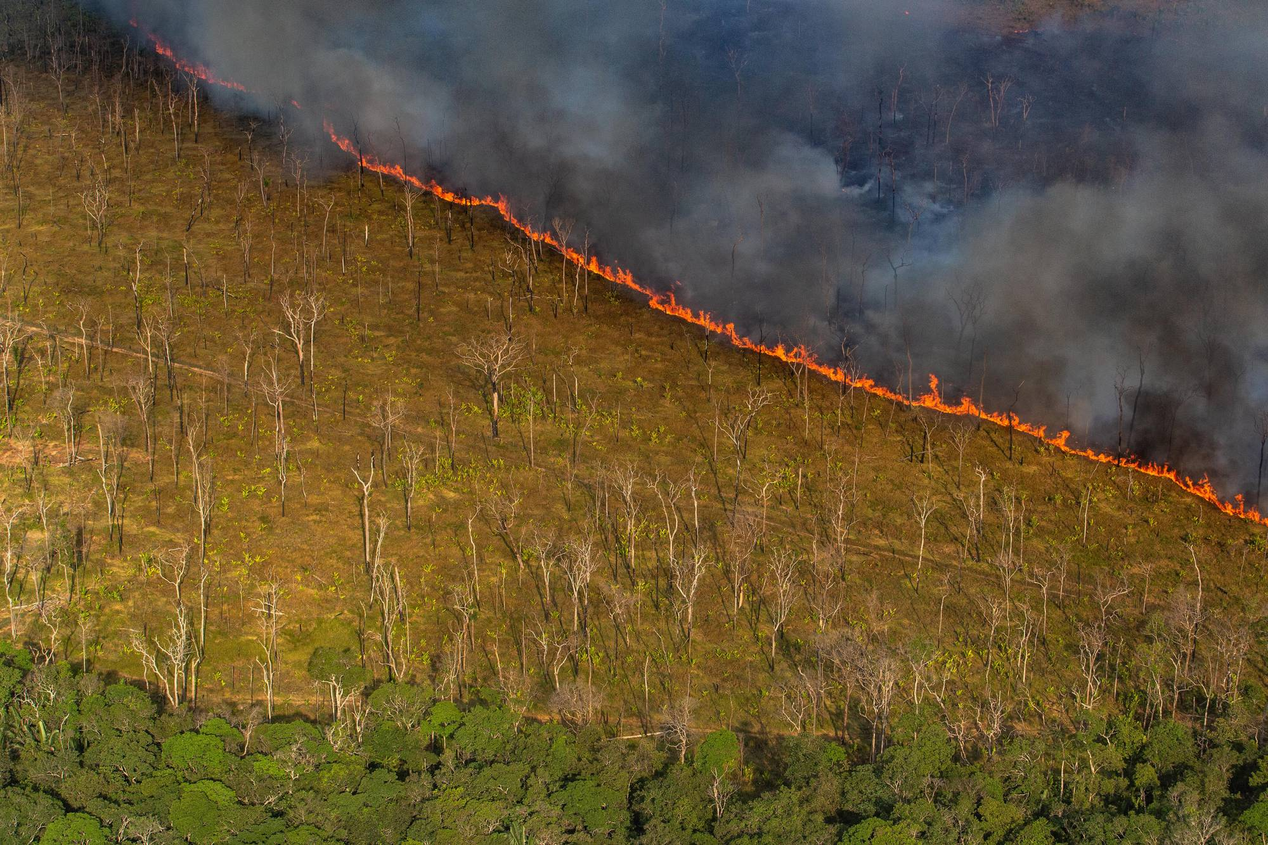
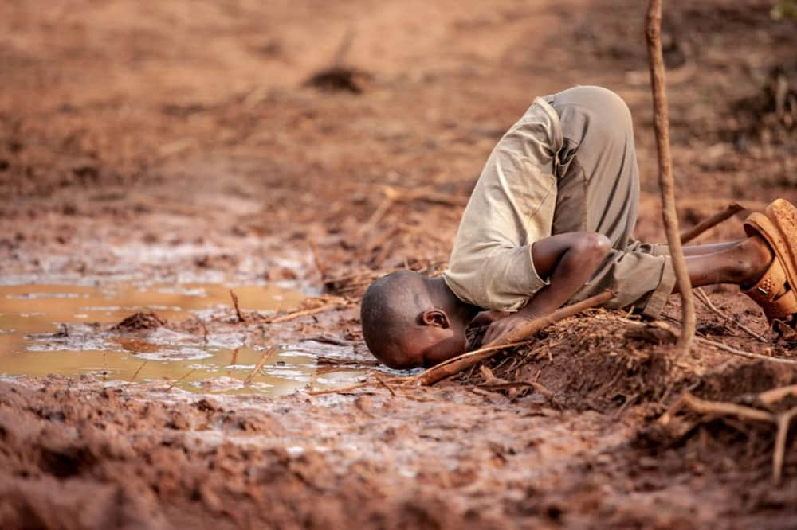
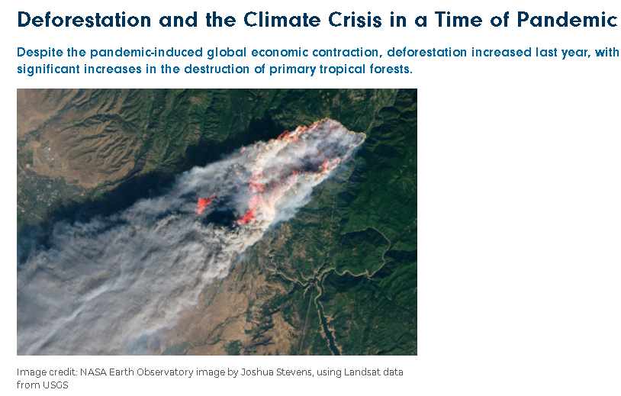
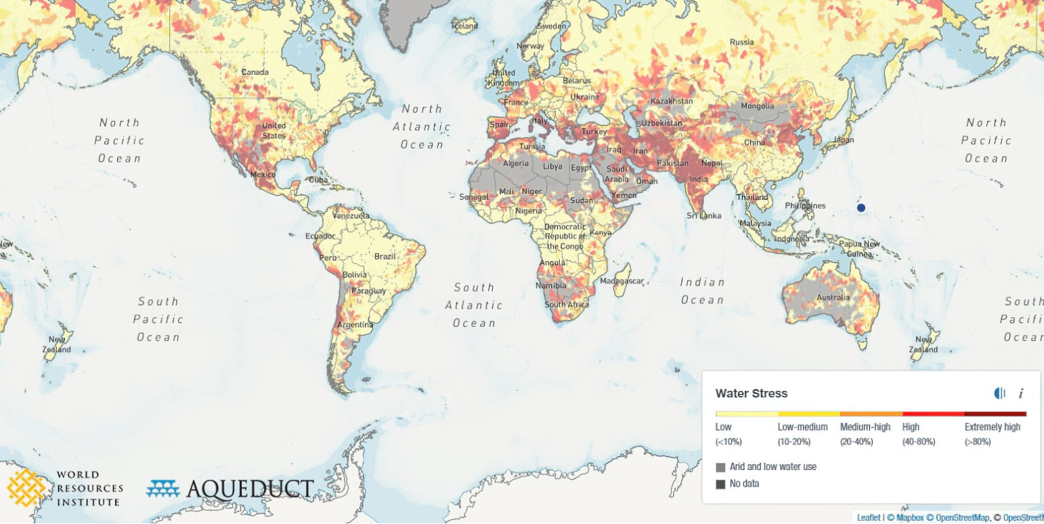
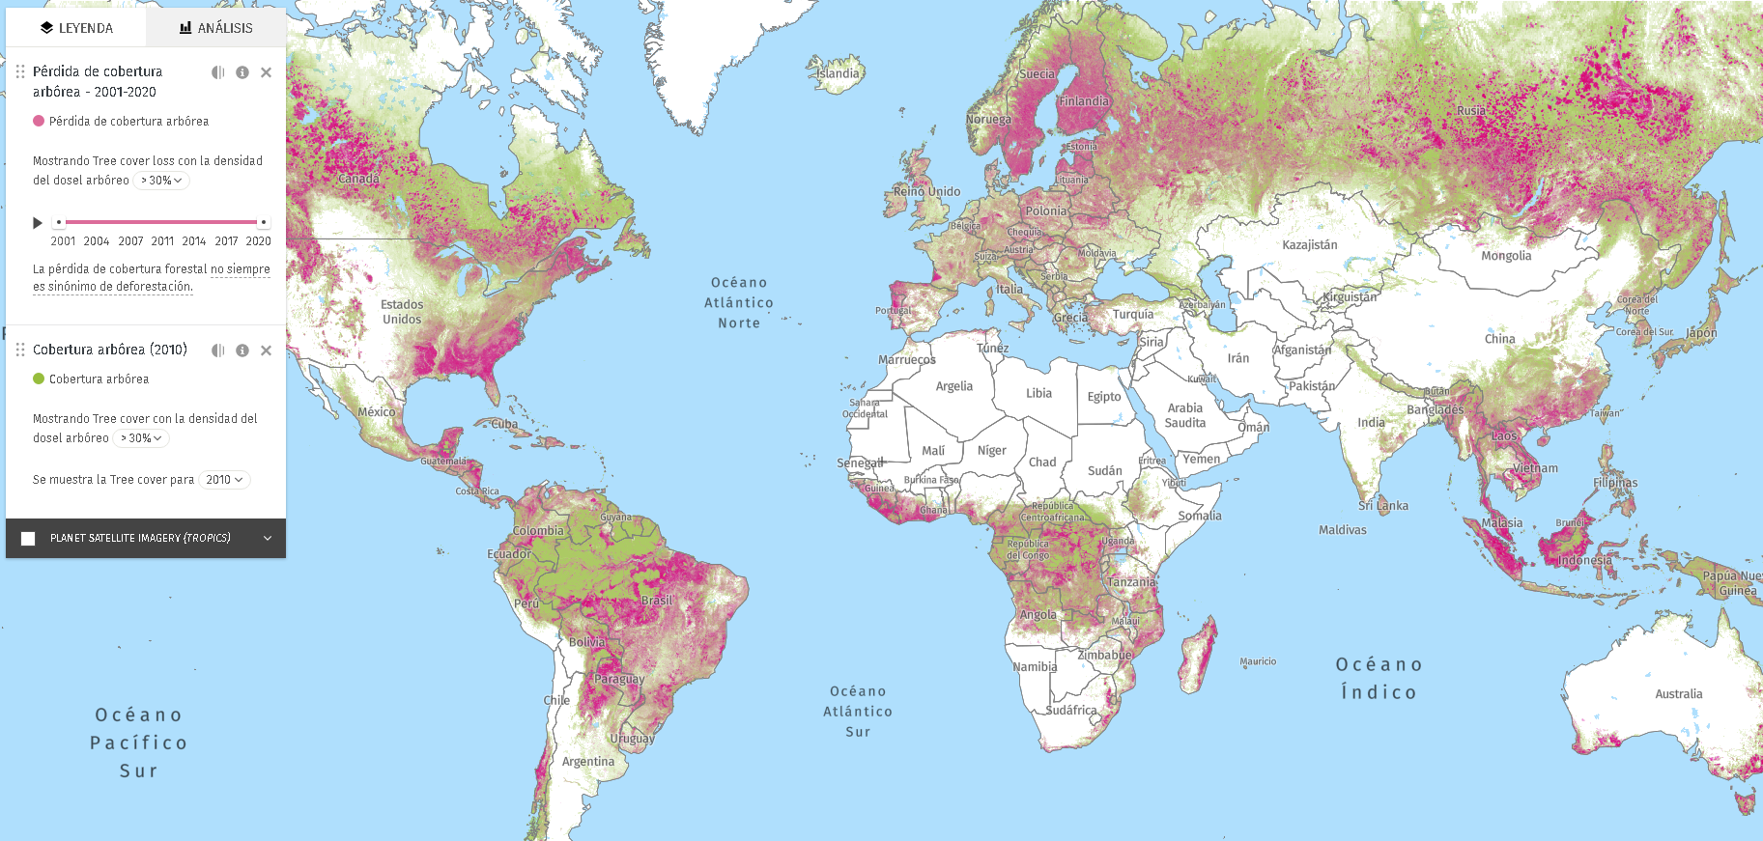
What is the problem?
URGENT!
Causes
IMPORTANT!
Water acces today
japantimes.co.jp
cc.gfamedia.org
wil.org
legal-planet.org
cc.gfamedia.org
globalforestwatch.org

Slide 6
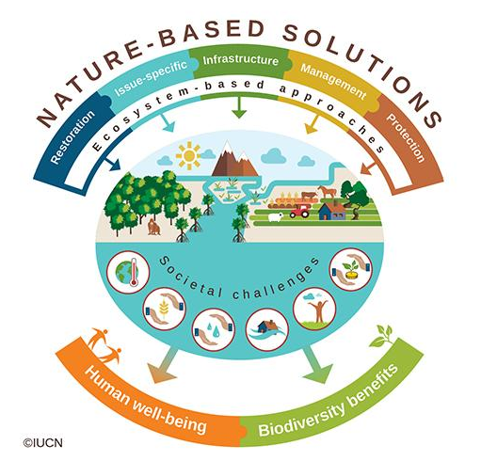
What is the problem?
URGENT!
Causes
IMPORTANT!
Water acces today
japantimes.co.jp
cc.gfamedia.org
Solution
Solution
wil.org
legal-planet.org
cc.gfamedia.org
globalforestwatch.org

Slide 7
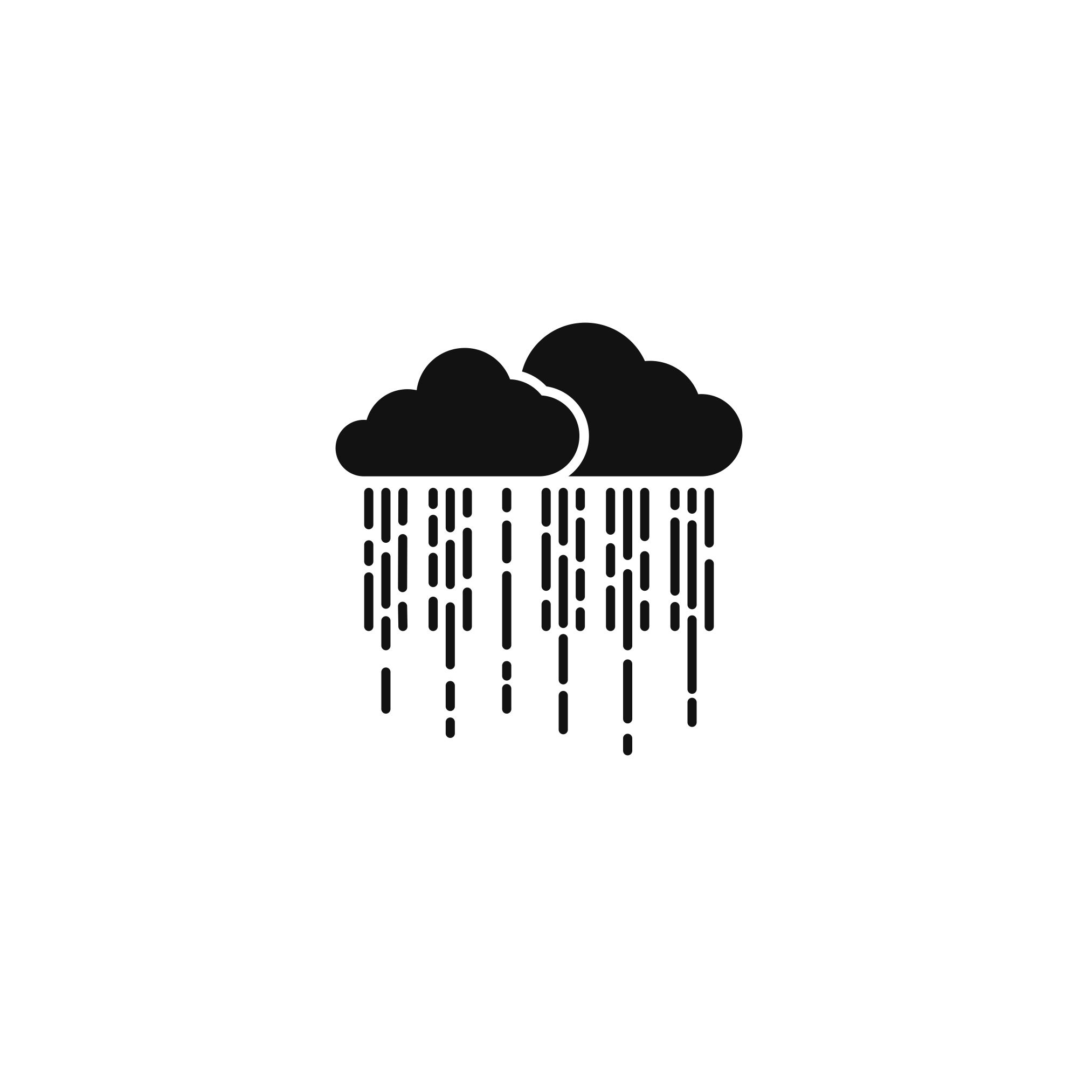
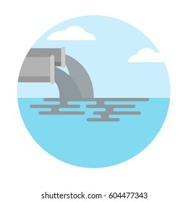



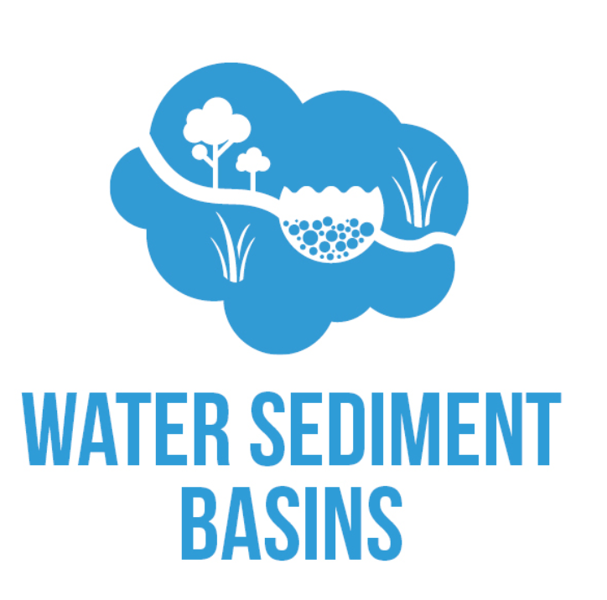



















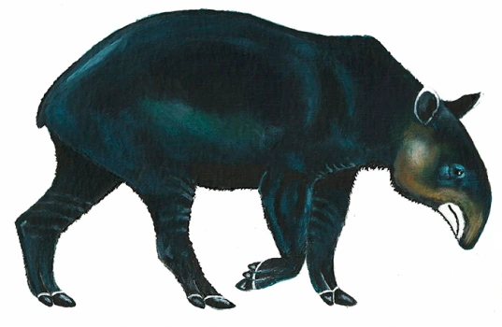






Nature Based Solutions (NBS)
-Wait, what (no investment)? Why?-
+
Clear
Trend:
Quality
Safe water
Drougths
Floods
-
+
Amount
Deforestation
Conservation
-
Sediments & pollutants
Beneficiaries:
Strategy: Avoid deforestation or restore forests
Execution: Single-time long- lasting effort
Costs: $0, or cheaper than delivery water bottles or build dams, drainages or channels

Slide 8




Goal
Provide a desktop/mobile platform for allow users to:
Find the closest river and basin geolocation in a map with one click in less than 5 seconds to solve urgent problem of water access
Estimate in less than 10 seconds the short-term historical trends of rainfall, temperature and forest cover to inform probability of water quality as inmediate problem
Identify historical deforestation inside a basin in about 15 seconds, and providing a map of current forest extent to inform decision makers where to conserve-restore and help mange the problem origin
Ayudar a usuarios (personas, empresas) a identificar la localización más cercana.
Soportar toma de decisiones de conservación y soluciones basadas en la naturaleza a través de datos históricos y espaciales

Slide 9


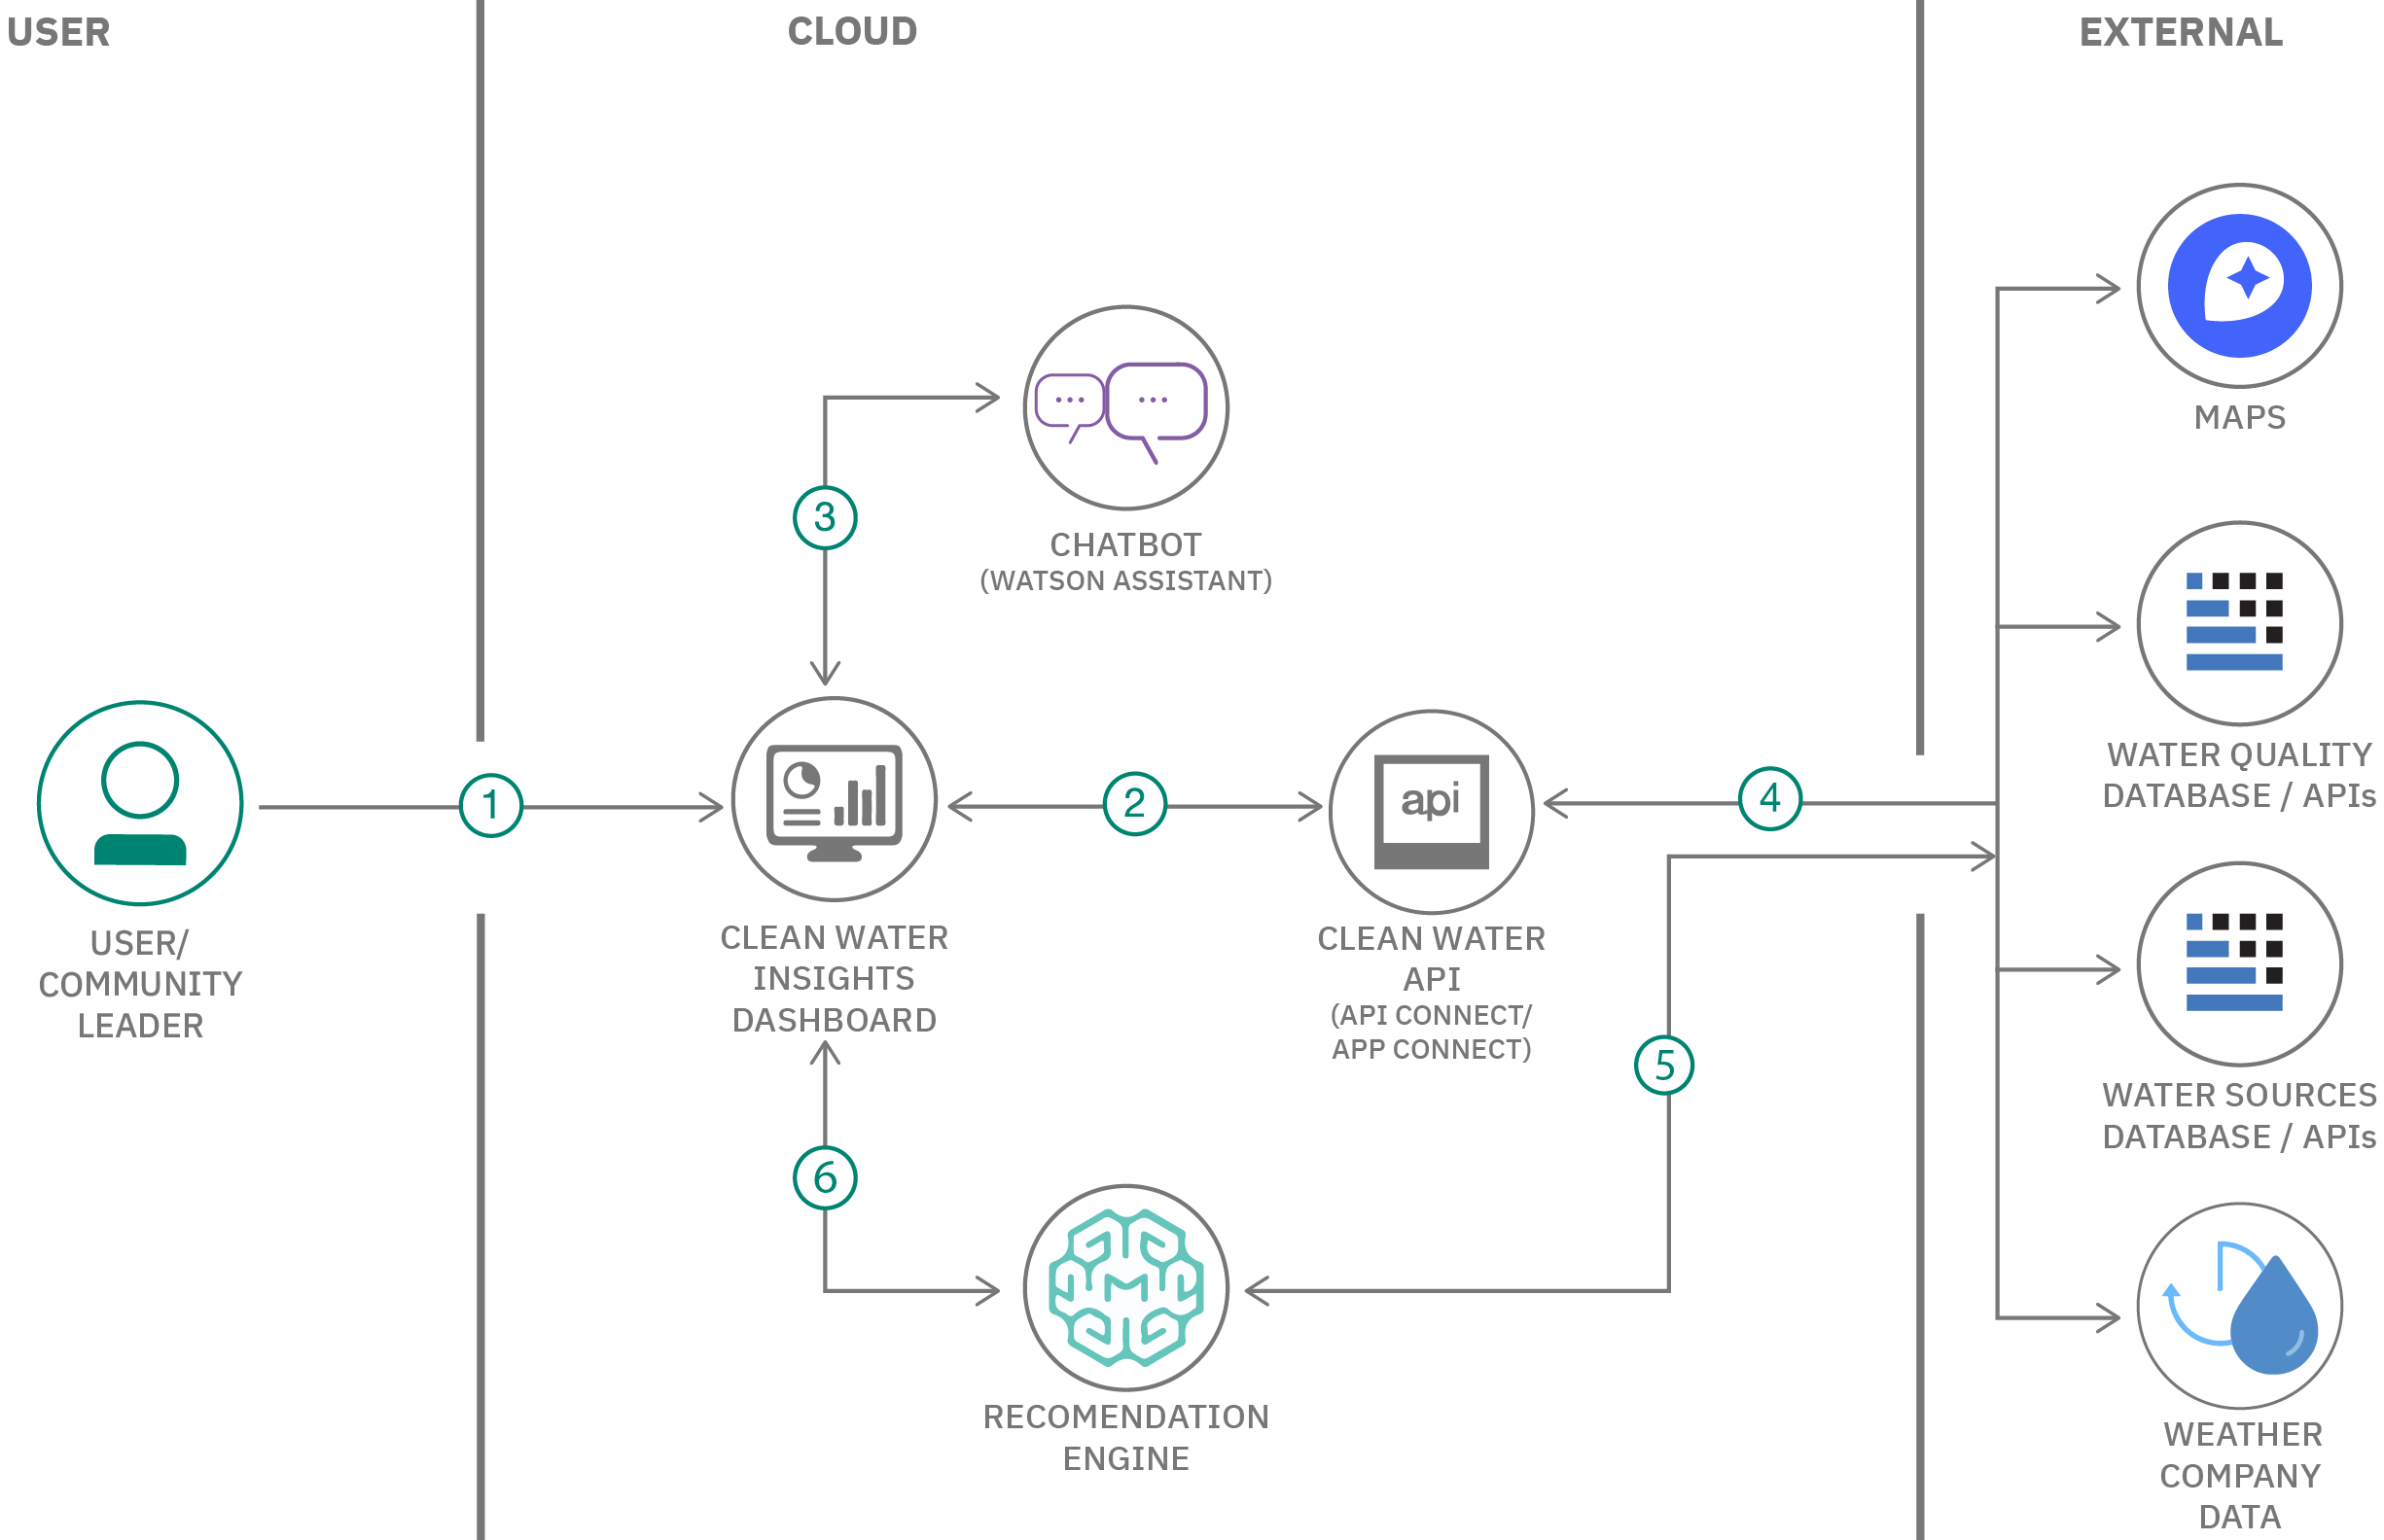

Architecture
IBM - Classic Vitual server
Ubuntu 20.04.2 LTS
+ Basins identification
+ Basemaps
+ Watson assistant
+ Earth Engine - NASA API
+ R Plumber
+ Rivers extraction
+ Deforestation maps
+ Watson Studio
+ R Shiny
+ Tresholds and quantiles
+ R Core
+ Rainfall & temperatura maps

Slide 10
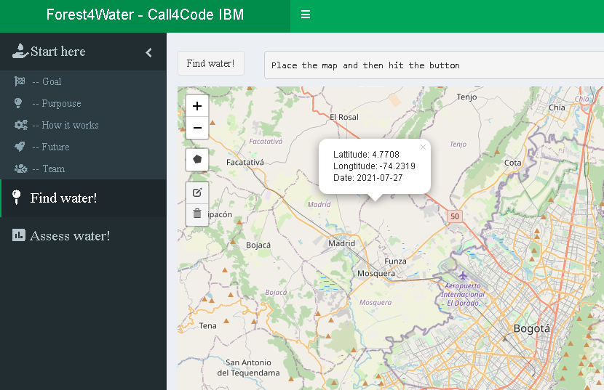
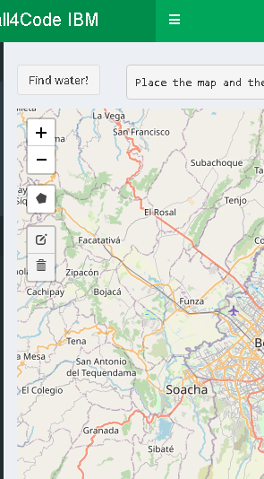
How it works?: 4 steps
0. Select a location (1 click)

Slide 11
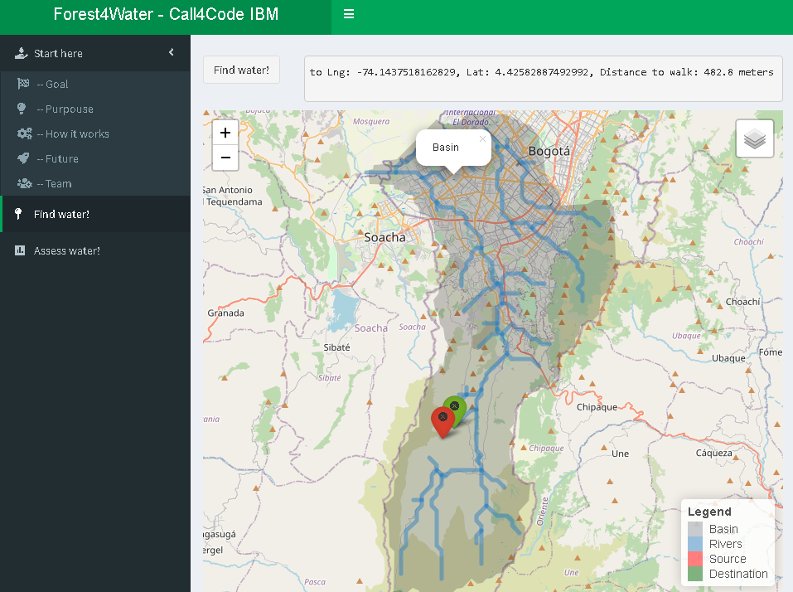
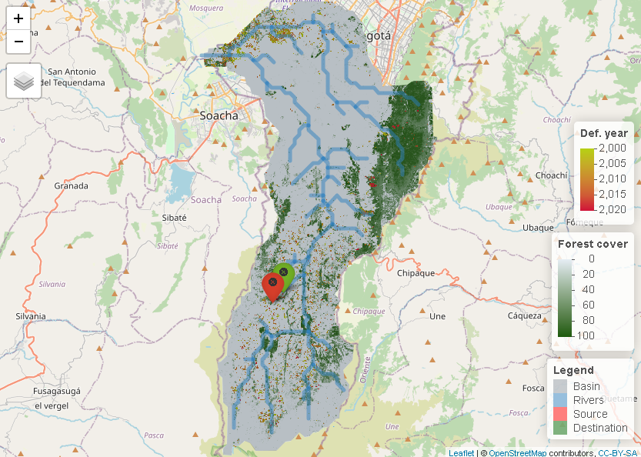
Obtén la ubicación de tu fuente hídrica más cercana
Tendencias espaciales en deforestación

Slide 12
Obtén la ubicación de tu fuente hídrica más cercana
Tendencias espaciales en deforestación

Slide 13
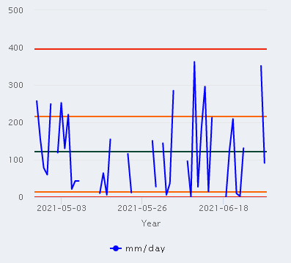
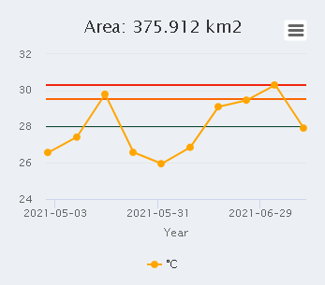
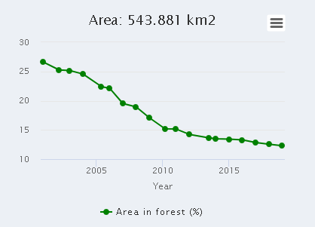
Lluvia (Corto plazo)
Temperatura (Corto plazo)
Deforestación
(largo plazo)

Slide 14
RoadMap
Analítica de información espacial responsiva
AI robusta
Prototipo con idea
Escalar la plataforma
Usar localización del usuario
Modularizar el sistema escalar en servicios IBM
1
3
5
1
3
5
2
4
6
Consumo de datos
100% Host en IBM
Nuevos datos
2
4
6
Usar nuevas fuentes de datos
Usar tecnologías robustas de inteligencia artificial
Generar dirección IP fija y usar otros idiomas

Slide 15






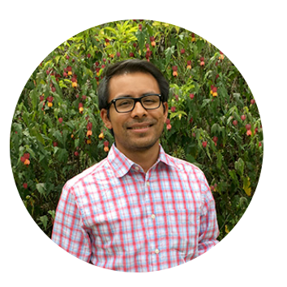




Gracias - Thanks - Obrigado
forest4water@gmail.com
Iván
González Ecologist
PhD Student – Ecoinformatics
Norther Arizona University (USA)
Ivan.Gonzalez@nau.edu
@gonzalezivan90
Fernando
Maldonado Computer systems eng.
Esp. Student – High performance distribuited processing
Veracruz technologic institute (Mex)
l15020799@veracruz.tecnm.mx
@ferjml97
Caleb Hernandez
Computer systems eng
Daniel
López Computer systems eng.
Msc. Student –Information eng.
Andes University (COL)
d.lopezl@uniandes.edu.co
@danflop

Slide 16
Some links
Climate change impact on flood and extreme precipitation increases with water availability | Scientific Reports (nature.com): https://www.nature.com/articles/s41598-020-70816-2
Summer of extremes: floods, heat and fire | World Meteorological Organization (wmo.int): https://public.wmo.int/en/media/news/summer-of-extremes-floods-heat-and-fire
Water Stress: A Global Problem That’s Getting Worse | Council on Foreign Relations (cfr.org): https://www.cfr.org/backgrounder/water-stress-global-problem-thats-getting-worse
Climate Change Indicators in the United States | US EPA: https://www.epa.gov/climate-indicators
Water Stress: The Unspoken Global Crisis - Gospel for Asia (gfa.org):
https://www.gfa.org/special-report/dying-of-thirst-global-water-crisis/
Most Important Conversation for Nature - WILD Foundation
Most Important Conversation for Nature - WILD Foundation

